Slide 1
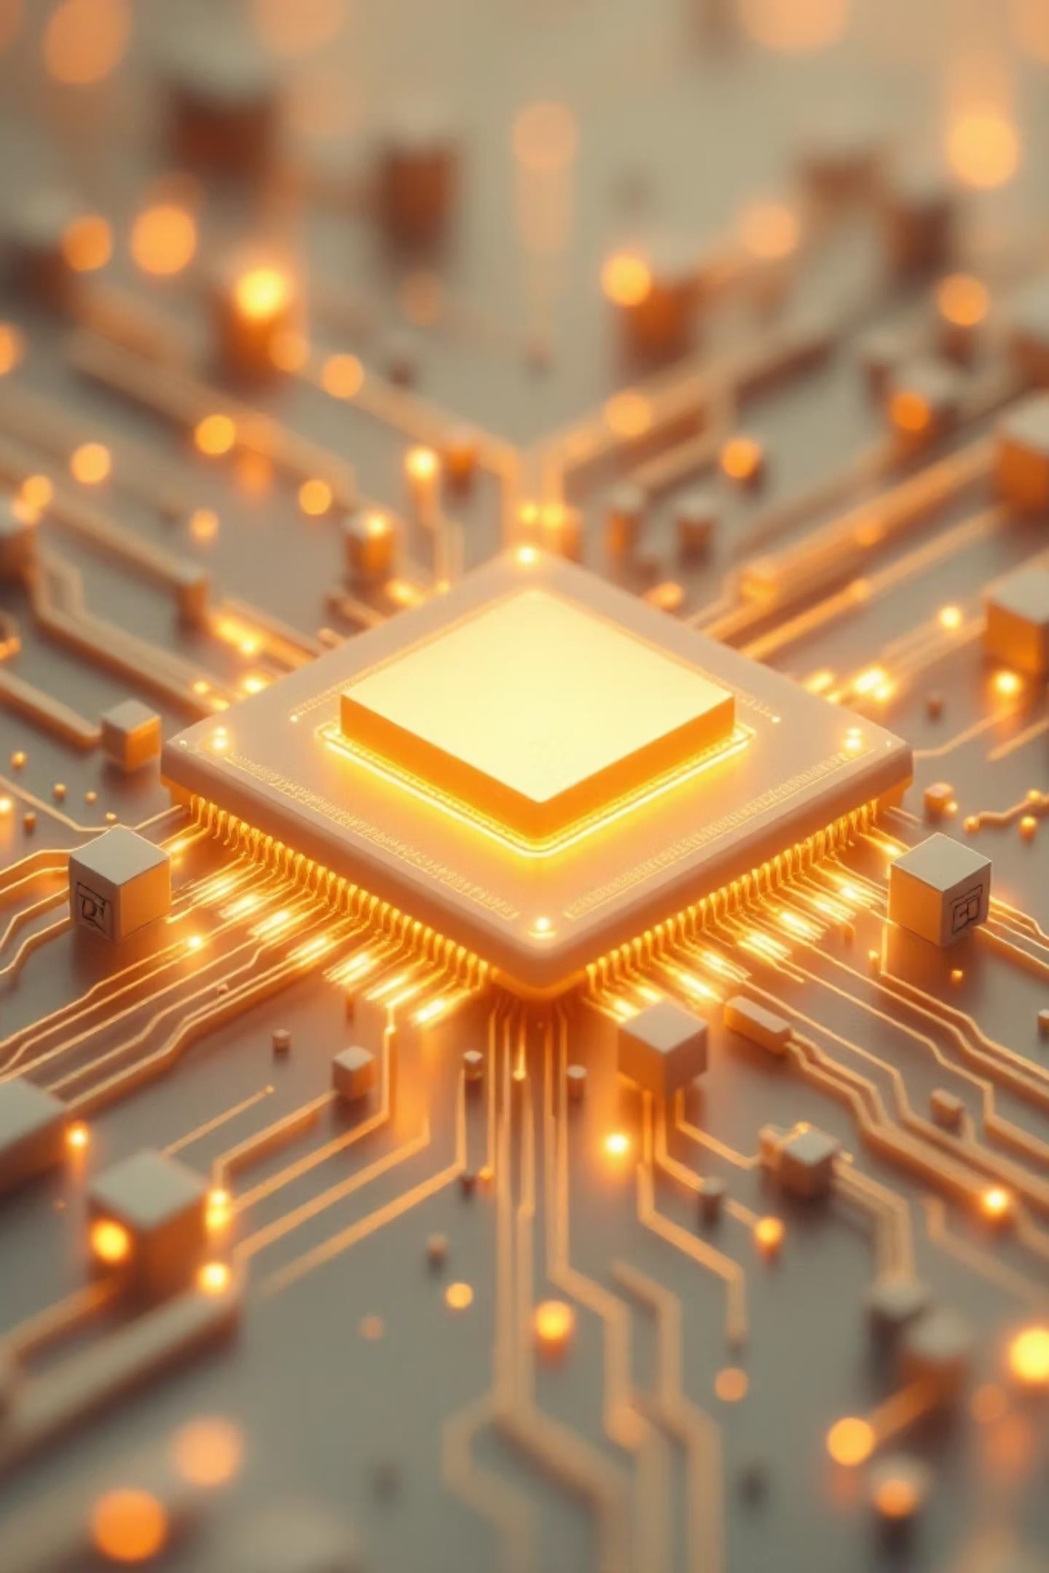
Cognitive Silicon: The Future of Brain-Like Chips
A university seminar exploring the next generation of computing technology that mimics how our brains work
NAME : M.SAINATH ROLLNO : 227Y1A66A2
GUIDE : MR.K.SRIKANTH

Slide 2

What is Cognitive Silicon?
Cognitive Silicon refers to brain-inspired computer chips that work more like the human brain than traditional processors. These chips use artificial neurons and neural networks to process information in a way that resembles how our brains think and learn.
Unlike conventional chips that follow strict programming instructions, cognitive silicon chips can learn from experience, recognise patterns, and make decisions based on incomplete information—just like we do.

Slide 3
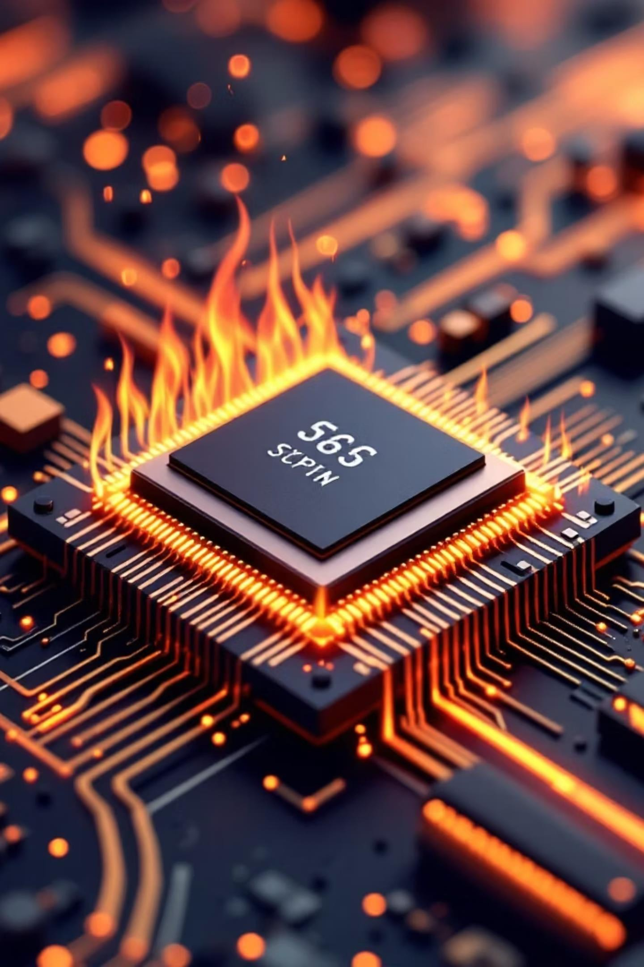

Why Do We Need Cognitive Silicon?
Power Problem
Traditional chips consume massive amounts of energy, making them inefficient for mobile and edge devices
Speed Limit
Conventional processors struggle with complex AI tasks that require real-time decision making
Learning Gap
Standard chips cannot learn or adapt easily—they need to be reprogrammed for every new task

Slide 4

How Brain-Like Chips Work
The Concept
These chips contain artificial neurons that communicate using electrical signals called spikes or pulses. When enough signals reach a neuron, it "fires" and sends signals to connected neurons—mimicking how brain cells work.
The connections between artificial neurons can be strengthened or weakened based on experience, allowing the chip to learn patterns and improve over time.

Slide 5

Cognitive Silicon vs Traditional Processors
Neuromorphic Chips
Massively parallel processing
Event-driven computation
Extremely low power consumption
Adaptive learning capability
Handles unstructured data well
CPUs
Sequential processing
Always-on operation
High power consumption
GPUs
Parallel but rigid
High power draw
Excellent for graphics
Limited adaptability
Requires precise data
Fixed programming Best for
structured tasks

Slide 6
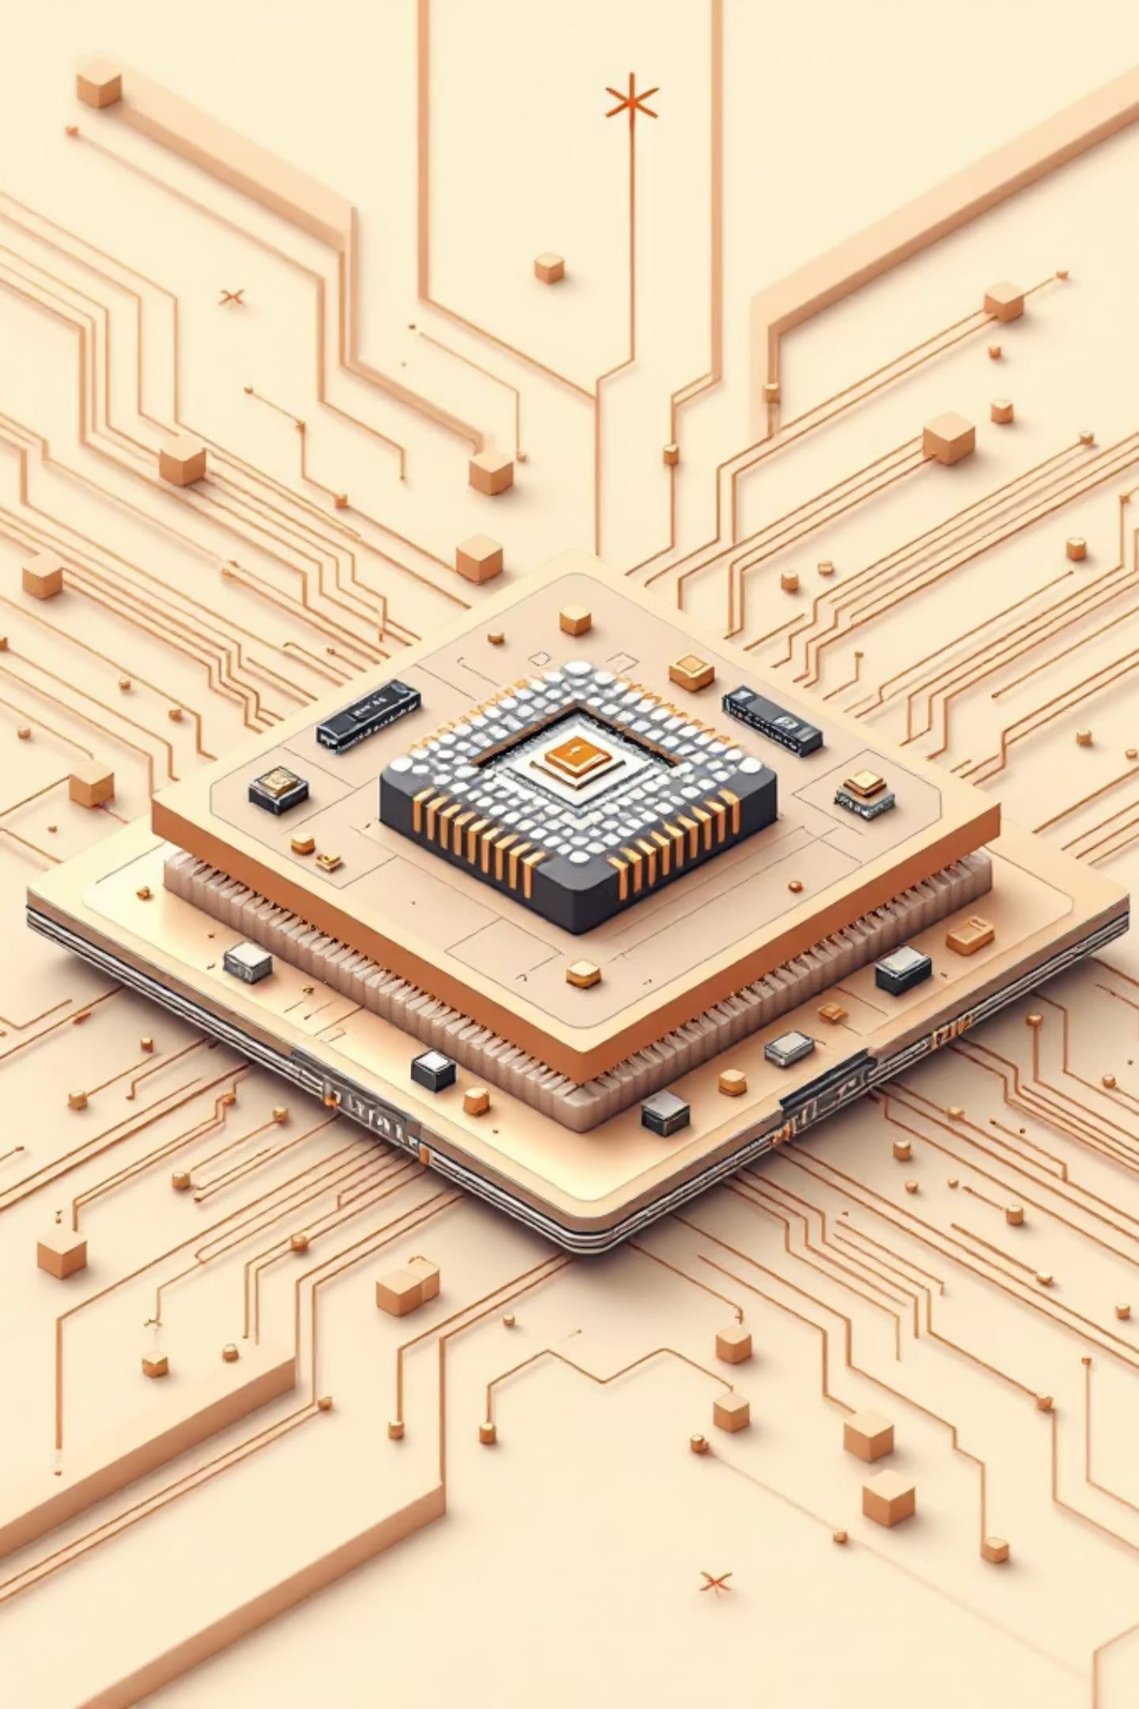

Key Technologies Behind Cognitive Silicon
Neuromorphic Computing
Hardware architecture designed to mimic the brain's structure, with interconnected processing units working simultaneously
Artificial Neurons
Electronic circuits that simulate biological neurons, capable of receiving, processing, and transmitting signals
Spiking Neural Networks
Networks that use timed electrical pulses to communicate, making them more efficient and brain-like than traditional neural networks

Slide 7
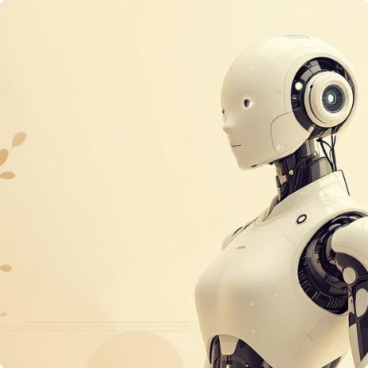



Real-World Applications
Robotics
Autonomous robots that learn from their environment and adapt to new situations in real-time
AI Systems
Smarter virtual assistants and chatbots that understand context and learn from conversations
Self-Driving Cars
Vehicles that process sensory
data instantly and make
split-second decisions for safety
Healthcare
Medical devices that diagnose diseases faster and monitor patient health continuously

Slide 8



Why Cognitive Silicon is Revolutionary
Energy Eﬃcient
Consumes up to 1000x less power than traditional chips by only activating when needed
Lightning Fast
Processes information in real-time without waiting for clock cycles, enabling instant responses
Superior AI
Better at pattern recognition, learning from data, and handling ambiguous information
Continuous Learning
Can learn on-the-fly from new experiences without being reprogrammed or rebooted

Slide 9

Challenges and Future Outlook
Current Challenges
Technical complexity: Designing chips that truly mimic brain functions is extremely difficult
High development costs: Research and manufacturing require massive
investments
Programming difficulty: Requires new tools and expertise different from traditional coding
Limited adoption: Still in early stages with few commercial products available
Future Potential
This technology could revolutionise computing in the next decade:
AI systems that think and learnlike humans
Truly autonomous robots and vehicles
Portable devices with supercomputer capabilities
Brain-computer interfaces for medical applications

Slide 10
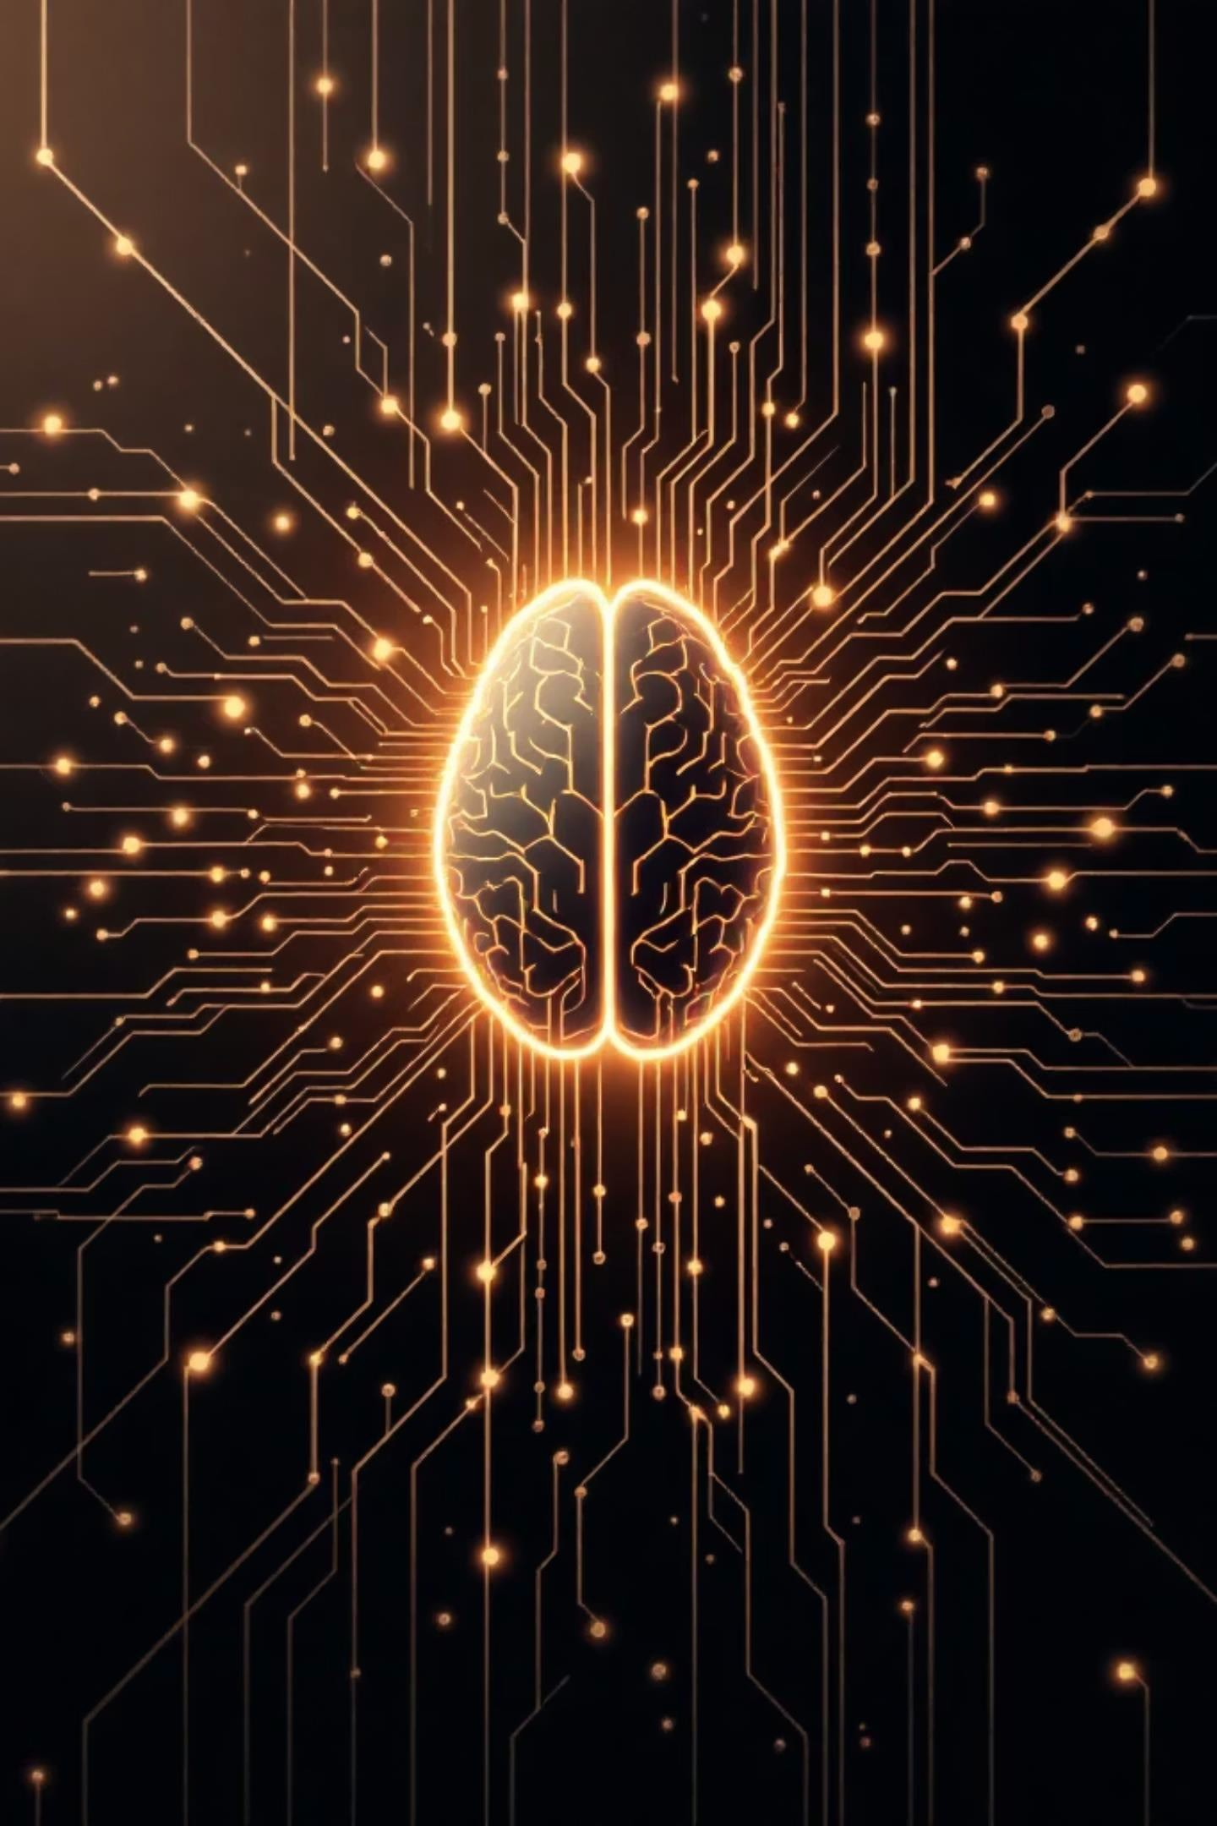
Conclusion: The Dawn of a New Computing Era
01 02
Bio-Inspired Innovation
Cognitive Silicon brings us closer to creating machines that think like biological brains
Eﬃciency Breakthrough
Dramatically reduces power consumption while increasing processing speed for AI tasks
03
Future-Ready Technology
Will power the next generation of artificial intelligence,robotics, and intelligent systems
"Cognitive Silicon represents a fundamental shift in how we build computers—moving from programmed machines to learning systems."
THANK YOU!!

Slide 11
THANKYOU

